Slide 1
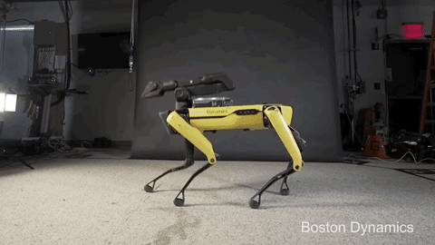
MUSIC
GENERATION
Week 2
Notes:
Lmao my contribution…..this dancing robot gif

Slide 2
Welcome back + tell us about your week!

Slide 3
Announcements / Agenda
General Announcements
Dues
Tree leaf form:
Review
Regression vs Classification
Working on our Project - generating MIDI files
HW Review

Slide 4
Review:
Topics
Insert slides from last week here

Slide 5
WHAT IS MACHINE LEARNING?

Slide 6
WHAT IS MACHINE LEARNING?
= the idea that there are generic algorithms that can tell you something interesting about a set of data without you having to write any custom code specific to the problem. Instead of writing code, you feed data to the generic algorithm and it builds its own logic based on the data.
--medium article by Adam Geitgey

Slide 7
Typical Steps
Acquire Data
Choose a model
Evaluate Model Performance
Prep / Visualize Data
Train model on training set
Tune Model Hyperparameters
Prediction
1
2
3
4
5
6
7

Slide 8
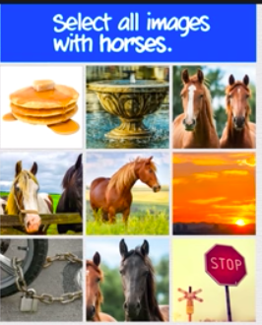
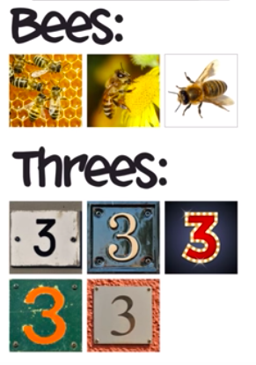
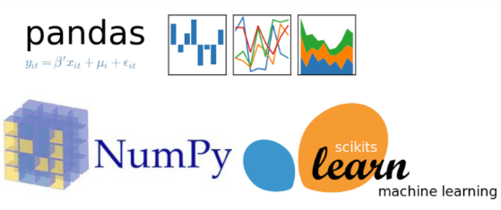
Part 1: Prepare the data

Slide 9
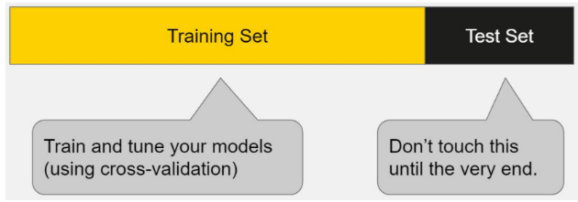
Part 2: Train and Test

Slide 10
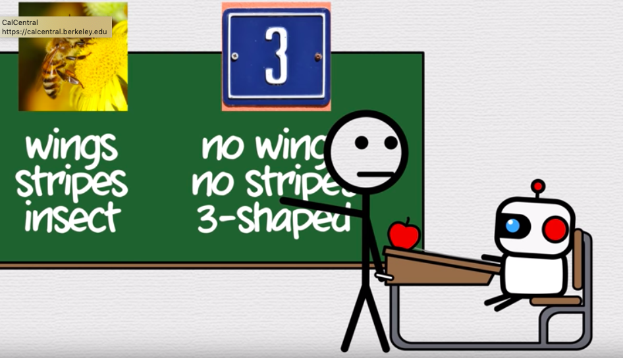
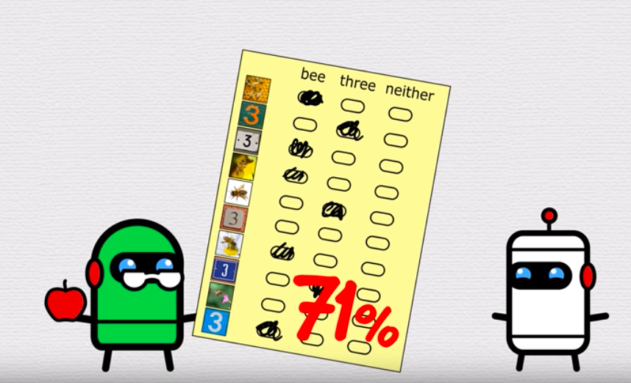
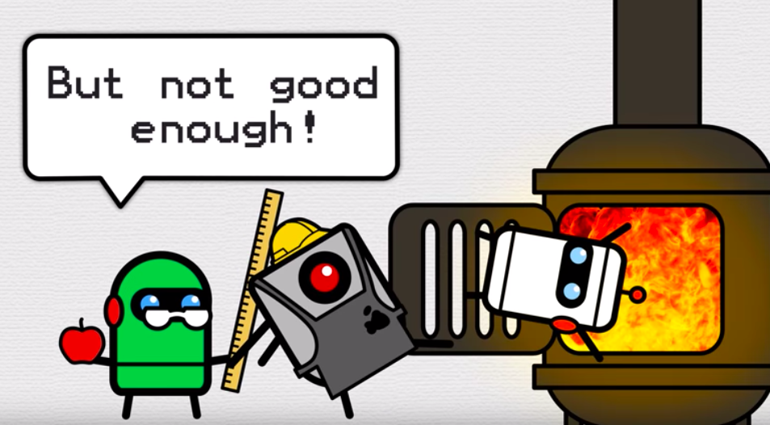
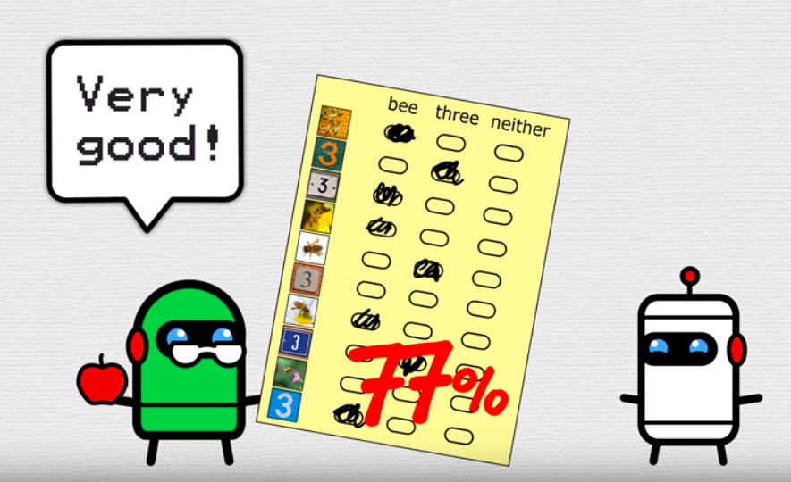
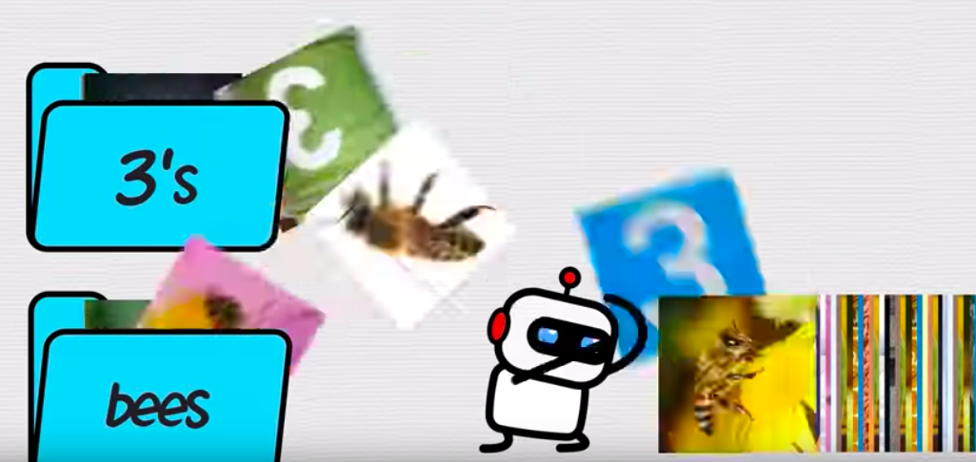
Part 2: Train and Test

Slide 11
...let’s hop right in!
this week
CLASSIFICATION & REGRESSION

Slide 12
How do we as people classify things?

Slide 13
How do we as people classify things?
We use examples from the past to tell us what makes a thing a thing
supervised learning -> ML that depends upon labeled datasets that we have “supervised” aka already have given a label to
Spam email detector based on spam vs not spam emails in your inbox

Slide 14

Models: a structured way of approaching different types of problems based on the info you have and the info you’re looking for
Notes:
Jennifer

Slide 15
How do we as people classify things?
We use examples from the past to tell us what makes a thing a thing
supervised learning
We group together the similar data points into one category
In ML this is known as clustering
Unsupervised learning
Examples include search engines (comparing documents/images to surface similar items) and video recommendation

Slide 16
Classification
In classification problems we are trying to predict a discrete number of values.
The labels(y) generally comes in categorical form and represents a finite number of classes. Consider the tasks below:
Given set of input features predict whether a Breast Cancer is Benign or Malignant.
Given an image correctly classify as containing Cats or Dogs.
From a given email predict whether it’s spam email or not.

Slide 17
Types of Classification
Binary classification - when there are only two classes to predict, usually 0 and 1 values.
Examples: whether an image is a hot dog or not
Multi-class classification - when there are more than two class labels to predict.
Examples: image classification, cancer types, etc.

Slide 18
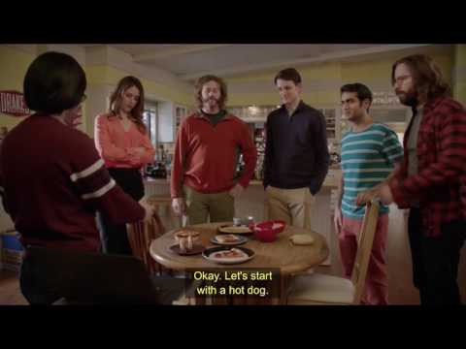

Slide 19
Algorithms for Classification
Decision Trees
Logistic Regression
Naive Bayes
K-NN
Linear Support Vector Classifier
Notes:
Maybe we can explain what each of these are a little bit if we have time?

Slide 20
Linear Regression
Last week we started talking about using models in ML, and the linear model is one of the most basic and fundamental models/
In regression problems, we are trying to predict continuous valued output based on information we have seen in the past.
For example, given the square footage of the house, predict the price (real value).
Or in our jupyter notebook example: we created a best fit line to predict mpg from displacement from a car

Slide 21
Regression Algorithms
Linear regression
Regression Trees (e.g. Random Forest)
Support Vector Regression
etc.
Notes:
What we did a little bit of in our demo. Describe each of these a little bit maybe?

Slide 22
Approaching a ML Problem
Whenever you begin tackling a ML problem, you should always identify whether you are dealing with a classification or regression problem.
Which of the two do you think music generation is?

Slide 23
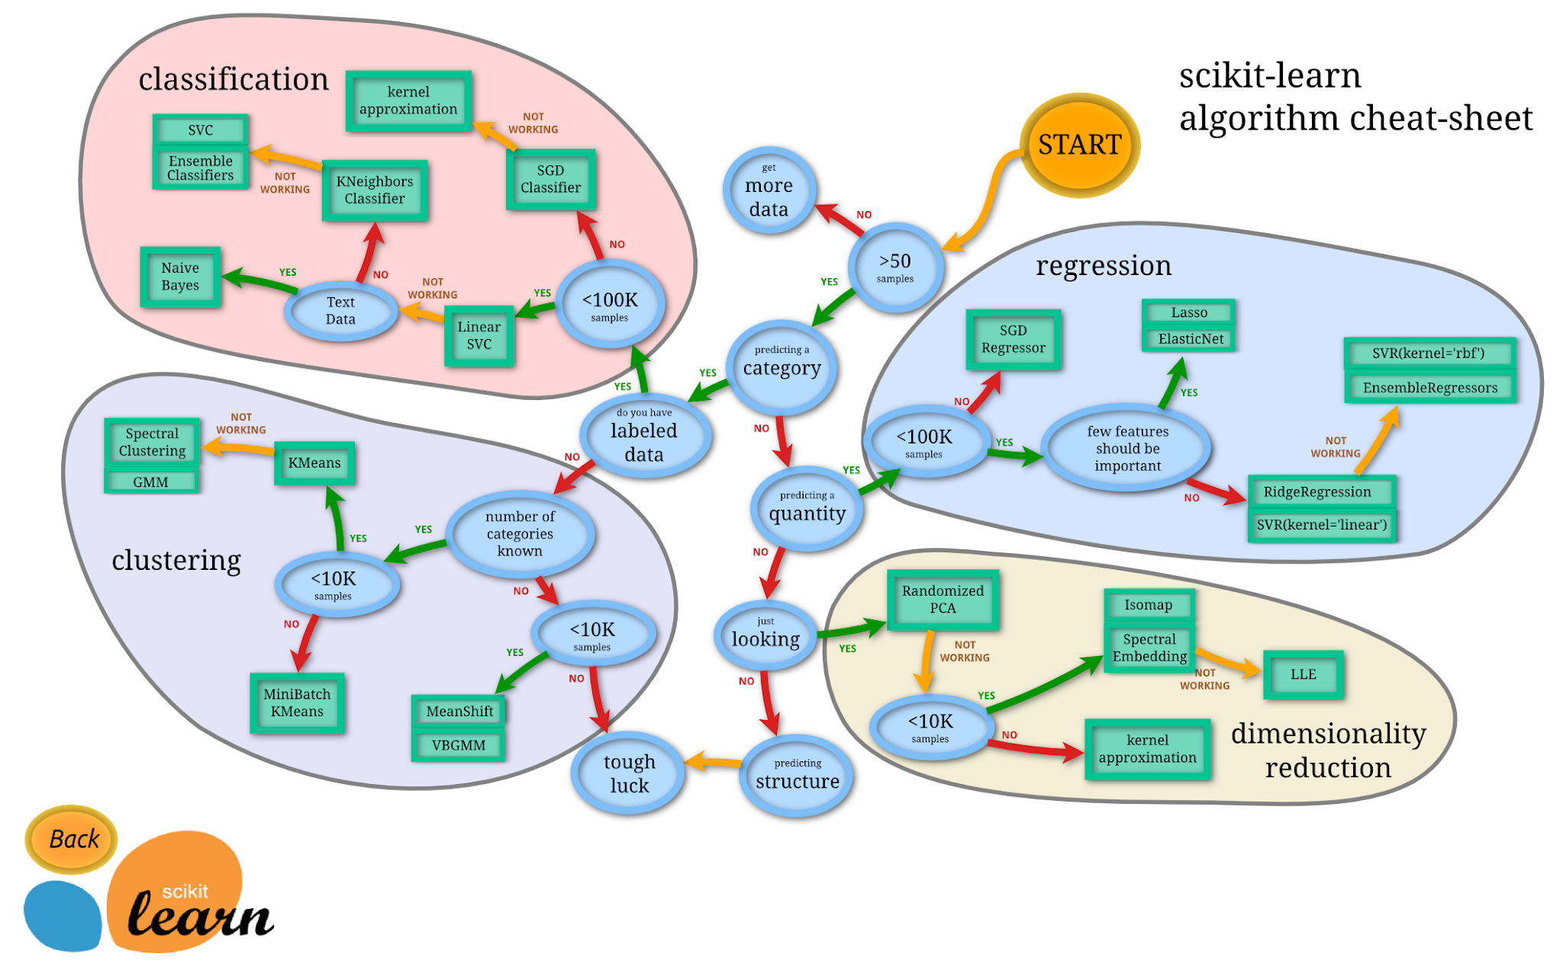

Slide 24
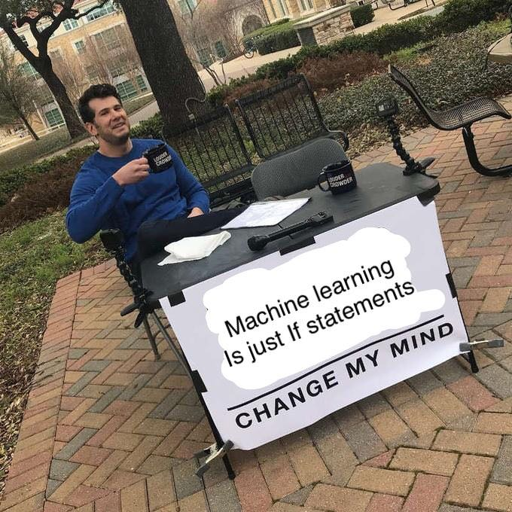
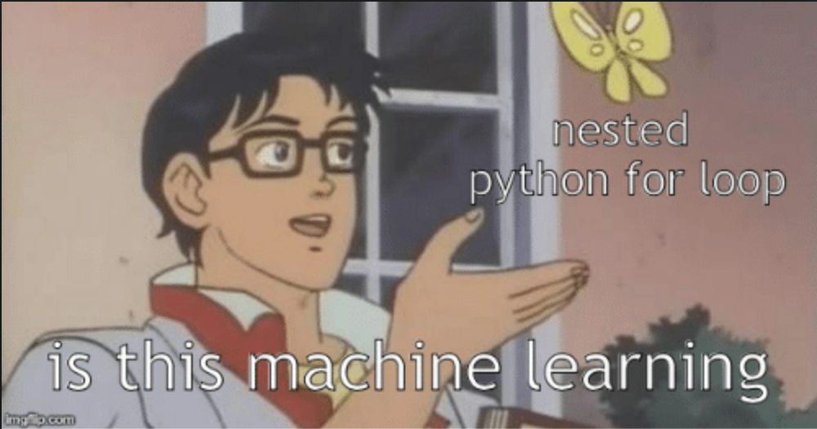
Approaching a ML Problem
Using trial and error as an algorithm

Slide 25
Let’s dive into
Linear Regression
&
Gradient Descent

Slide 26
Gradient Descent
In linear regression, we create the best fit line by minimizing our cost fn / the total distance from each point to our best fit line.
Gradient Descent = an optimization alg that allows to us to find the best fit line or the best model of minimum cost.
-> also can be applied to neural nets, but we will use linear regression since that is much more simple
Notes:
Have this done

Slide 27
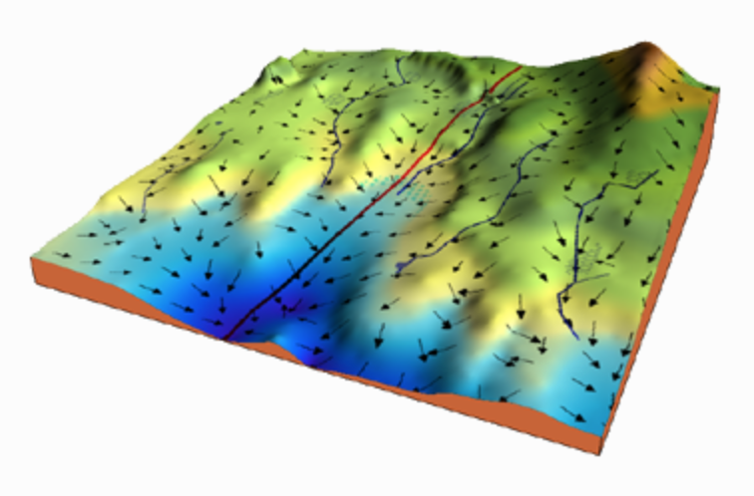
Gradient Descent
Our goal is to minimize our cost fn.
Consider this 3D map of a cost function, to get to the dark blue arrows, we would want to take the “steepest arrow down” and stop moving when any other change would increase our cost
The “Steepest Arrow” is some change to a
weight or parameter in our alg that
leads to a change in our cost function
Notes:
Have this done

Slide 28
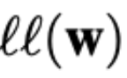
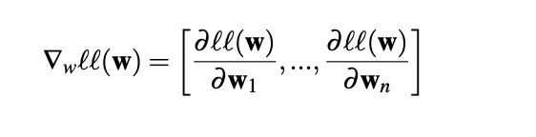
Gradient Descent - the math
We have a loss function ` that calculates the loss (aka the cost) if we use a set of weights
We take the partial derivative:
over each weight
Notes:
Have this done

Slide 29
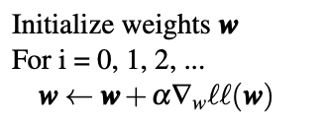
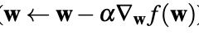
Gradient Descent - the math example
So we have a “gradient” calculating ho change in cost
Then we keep adjusting our weights in a for loop:
Notes:
Have this done

Slide 30
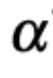
Gradient Descent - the math example
So we have a “gradient” calculating ho change in cost
Then we keep adjusting our weights in a for loop:
Ex. if a weight w, causes the cost to go down, we want to “use” that weight more, so we increase it
Our learning rate determines how fast we allow our weights to change values
Notes:
the learning rate very carefully since it should neither be very large that the optimal solution is missed and nor should be very low that it takes forever for the network to converge.

Slide 31
Gradient De
EDIT IN GOOGLE SLIDES
Click on the button under the presentation preview that says "Use as Google Slides Theme".
You will get a copy of this document on your Google Drive and will be able to edit, add or delete slides.
You have to be signed in to your Google account.
More info on how to use this template at www.slidescarnival.com/help-use-presentation-template
This template is free to use under Creative Commons Attribution license. You can keep the Credits slide or mention SlidesCarnival and other resources used in a slide footer.
Notes:
W

Slide 32
Summary:

Slide 33
Models: we just took a look @ supervised learning ->
Now lets
summarize
And connect it back
to our project...
Our HW from last week
Notes:
Jennifer

Slide 34
Summary
Unsupervised Learning
Finding relationships in data to fit a more general goal where the output is less defined - e.g. netflix recommendations
Not our main focus
Supervised Learning
Using data for a specific output
E.g. forecasting house prices based on sqft
Linear regression is basic alg
Reinforcement Learning
Takes actions and learns from the
response to generate best reward
Uses gradient descent similar to supervised learning
to minimize cost or max reward
But does not rely strictly on set of “supervised” (or labeled) data (the training set)
Source: https://medium.com/@machadogj/ml-basics-supervised-unsupervised-and-reinforcement-learning-b18108487c5a
Notes:
Jennifer

Slide 35
Now to our actual project….
Lets build stuff!!

Slide 36
Magenta Library
ML library for art and music built by Google
Has a bunch of different models - synthesizers, piano transcribers and more
https://quickdraw.withgoogle.com/data was made with Magenta!
If you want to install it to your local computer: pip install magenta in terminal

Slide 37
What we will be doing this week:
Making “Note sequences” to train next week!!
Note sequences are an object in the Magenta library
They are an abstract representation of a sequence of notes, designed similar to MIDI but built to represent any music sequence of any different pitch, instrument, and strike velocity
Are “protocol buffers” meaning they are a “fast and efficient data format, easier than MIDI

Slide 38
Steps for this week
Make your own Collab notebook
Install Libraries
Allow your Google Collab notebook to have access to files in your Google Drive
Try googling how to do this (hint)
Find a basic MIDI file with a simple melodic structure
Import your chosen MIDI file through your drive
Convert your MIDI file into NoteSequences through a NoteSequence method by looking up documentation for Magenta Library / Googling it
Make sure you can play your NoteSequence using another NoteSequence method
(Optional) you can build your own NoteSequence from scratch, and build your own melody

Slide 39
Scripts to install necessary libraries
#@test {"output": "ignore"}
print 'Installing dependencies...'
!apt-get update -qq && apt-get install -qq libfluidsynth1 fluid-soundfont-gm build-essential libasound2-dev libjack-dev
!pip install -qU pyfluidsynth pretty_midi
!pip install -qU magenta
# Hack to allow python to pick up the newly-installed fluidsynth lib.
# This is only needed for the hosted Colab environment.
import ctypes.util
orig_ctypes_util_find_library = ctypes.util.find_library
def proxy_find_library(lib):
if lib == 'fluidsynth':
return 'libfluidsynth.so.1'
else:
return orig_ctypes_util_find_library(lib)
ctypes.util.find_library = proxy_find_library
print 'Importing libraries and defining some helper functions...'
from google.colab import files
import magenta.music as mm
import magenta
import tensorflow
print '🎉 Done!'
print magenta.__version__
print tensorflow.__version__

Slide 40
HW Review:
Topics
Insert slides from last week here

Slide 41
How will we make Note Sequences?:
If you want to do it outside of a collab notebook:
Find music you want to use, preferebly in a MIDI format or MusicXML or ABC file
Follow the READMe for the library here: https://github.com/tensorflow/magenta/blob/master/magenta/scripts/README.md
(The goal here is for you to learn how to research cool things about CS by following the limited documentation on the internet, rather than for us to spoonfeed you the code!)

Slide 42
Homework / Summary
What we did this week:
Regression vs Classification
Gradient Descent so we can apply that next week for Neural Nets
What you have to do before next week:
Create your training data Note Sequences from a song you like

Slide 43
Resources
Magenta Docs:
https://github.com/tensorflow/magenta/tree/9307d9cb450584057a587b3368031f8acb79708f/magenta/music
Links to more learning material:
Gradient Descent - https://ml-cheatsheet.readthedocs.io/en/latest/gradient_descent.html
https://www.analyticsvidhya.com/blog/2017/03/introduction-to-gradient-descent-algorithm-along-its-variants/
https://medium.com/@machadogj/ml-basics-supervised-unsupervised-and-reinforcement-learning-b18108487c5a
As always feel free to slack or message either of us if you have any questions <3

Slide 44
OUR PROCESS IS EASY
first
second
last

Slide 45
SlidesCarnival icons are editable shapes.
This means that you can:
Resize them without losing quality.
Change fill color and opacity.
Change line color, width and style.
Isn’t that nice? :)
Examples:

Slide 46
😉
Now you can use any emoji as an icon!
And of course it resizes without losing quality and you can change the color.
How? Follow Google instructions https://twitter.com/googledocs/status/730087240156643328
✋👆👉👍👤👦👧👨👩👪💃🏃💑❤😂😉😋😒😭👶😸🐟🍒🍔💣📌📖🔨🎃🎈🎨🏈🏰🌏🔌🔑 and many more...

